Slide 1
RULES FOR THE 2025 SOLAR CAR CHALLENGE

Slide 2
EVENT UPDATES
The Rules are periodically clarified or amended to meet the needs of the specific race.
Rule 29 requires solar car teams to make periodic reviews of these updates to stay up-to-date.

Slide 3
Rules Overview
Do:
Keep copies of rules throughout workshop
Following engineering lifecycle: requirements, design, implementation, verification
Don’t:
Just read once or all in one sitting
Look at another car’s design and assume it complies with rules (grandfather; waivers)

Slide 4
Important Dates
September 1 to January 31 - “Intent-to-Race” Form
This notifies Race Officials that you plan to participate in the 2019 Solar Car Challenge, and places your team on a mailing list to receive Event Updates and other mailings. This form must be
filed to file a registration document.
March 1st - File Registration Document
This includes full documentation about your solar car project as required by Rule 3.6, and your team’s
registration fee.

Slide 5
Registration
Sections 1 – 3: Purpose, Administration, Entries and Registrations
Registration Documents and Registration Fee requirement March 1st:
(1) Detailed CAD drawings showing mechanical structure, including “safety cell.” Crush zones must be clearly labeled.
(2) Detailed schematic / wiring diagram showing electrical system.
(3) Digital team photo [emailed]
(4) Manufacturer’s data sheets for batteries showing type & nominal capacity
(5) Manufacturer’s data sheets for solar array, including cell list price
(6) Manufacturer’s data sheets for motor and motor controller
(7) Manufacturer’s data sheets for array and battery cutoff switches
(8) Manufacturer’s data sheets for main fuses
(9) Manufacturer’s data sheets for brakes, brake calipers, brake pedals and master cylinder
(10) Manufacturer’s data sheets for steering mechanism
(11) Manufacturer’s data sheets for wheels & tires
Digital and hard copies required by March 1st.
[Rule 3.6]

Slide 6
Incomplete Registration
3.6.1 Incomplete Registration – Teams not submitting the required documentation by the registration deadline will incur a 3 mile penalty for each piece of missing documentation

Slide 7
Rule 3.8 – Design of Solar Car
It is the intent of the event that the solar cars be designed and constructed by high school students on the solar car team.
No portion of another vehicle’s frame may be reused in a solar car.
Teams may use off-the-shelf components (e.g., wheels & hubs, brake calipers, power trackers, motors, motor controllers, steering, suspension, etc.)

Slide 12
Rule 3.9 - Scrapbook
Scrapbook must be shown at Check-In to Race.
Scrapbook must show history of the team building the solar car, including team engineering decision-making.
Scrapbook will show team photos, design & planning, CAD drawings, fundraising, testing.
Digital copy of scrapbook due June 15th.

Slide 13
Rule 3.10 – Oral Presentations
Up to 25 laps available forever miles for oral presentation videos, and scrapbooks.
Presentation must discuss the teams overall planning, including engineering decisions.
Teams have a strict 8 minutes to give their presentation. [Use all your time!]
Teams will also be required to answer questions about their videos during Scrutineering

Slide 14
Section 10: DIVISIONS
Classic Division: No hub motors; lead-acid batteries; solar modules at ≤ 23% efficient
Advanced Classic Division: 3 or more years in classic with same basic vehicle structure and major components
Advanced Division: Hub motors; prefabricated solar car molds; advanced battery chemistries; solar cells greater than 23% efficient
Electric-Solar Powered Car Division: Solar cells on charging station; Classic Division technology; 2 x 5.25 kWh battery packs; workable trunk; 2.5 kW solar array.
Cruiser Division: Seating for four; totally enclosed; solar array integrated into the skin of the vehicle; workable trunk; two roll bars.

Slide 15
Section 5: SOLAR CAR REGULATIONS 5.1 – Dimensions – Length = 5m, Height = 1.6m, Width = 1.8m 5.1.2 – Stability [Tilt Test] 5.1.3 – Body of Vehicle – windshields required, but body is not required unless judges determine that driving without a body would be unsafe. A belly pan is required. 5.2 – Structure – teams must be able to demonstrate specific, adequate “crush zones.” 5.2.1 – Safety Cell welded to frame (1.9cm OD; 5cm clearance from driver; 15 cm 5.2.2 - Roll Bar welded to frame and must be 5cm above driver’s head. Must be one continuous piece of of unkinked metal. 5.2.3 – Crush Zone - Must be crush zone structural components at least 15 cm of horizontal distance away from the outside of the safety cell.

Slide 16
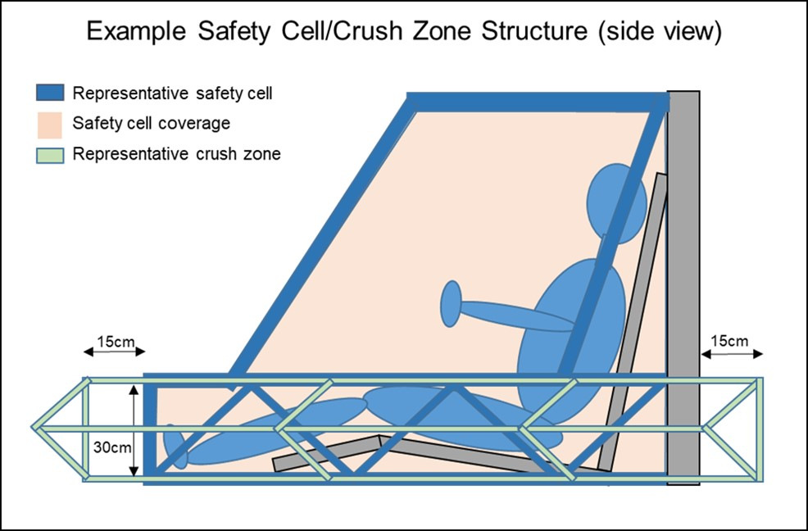

Slide 17
5.3 – Solar Array
Solar Cell efficiency is determined by Racing Division [Rule 10]
5.4 – Battery
The total battery capacity cannot exceed 5.25 kilowatt-hours at a 20 hour discharge rate (for lead-acid) or at a 1C discharge rate at nominal voltage (for LiFePO4).
Battery Protection – Lithium-chemistry batteries must be protected by a Battery Management System that detects overvoltage, undervoltage, and overtemperature monitored at the cell level

Slide 18
Main Battery Pack Fuse – The main battery pack fuse must be placed first in series off positive terminal of the main/propulsion.
Battery boxes must be protected by the crush zone.
Battery boxes for lead/acid batteries must have forced air ventilation; battery boxes for Lithium Iron Phosphate batteries MAY have forced air ventilation.

Slide 19
Section 5.4 - ELECTRICAL
[5.4] Batteries: 5.25 kWh max at 20 hr discharge rate and must have locking washers at the terminals.
[5.4.2] Main Fuse: 125% of expected peak current, separate enclosure; Rated as appropriate for DC voltage; ← Made by Copper Bussman (~$20) ANN = Very Fast Acting
[5.4.3] Enclosures: Rigid and air tight.
[5.4.4] Supplemental Batteries: Powers all devices other than propulsion; must have low battery warning system
[5.4.5] Disconnect Switches: Must be push or push-rotate off; 2 each of motor and array disconnects. Switches operate relay/contactors to removed HV from driver compartment.

Slide 20
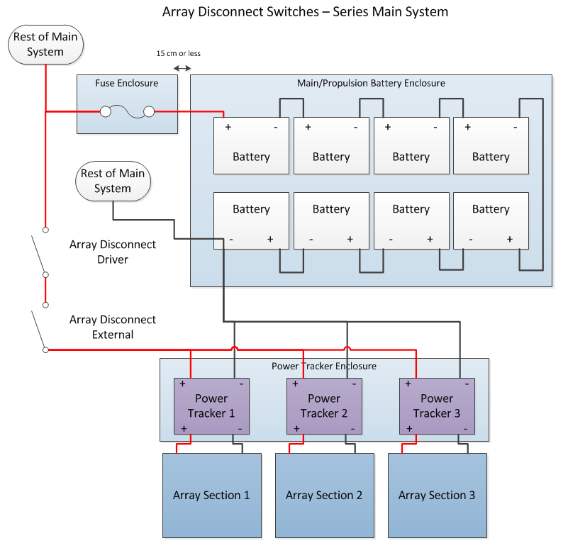

Slide 21
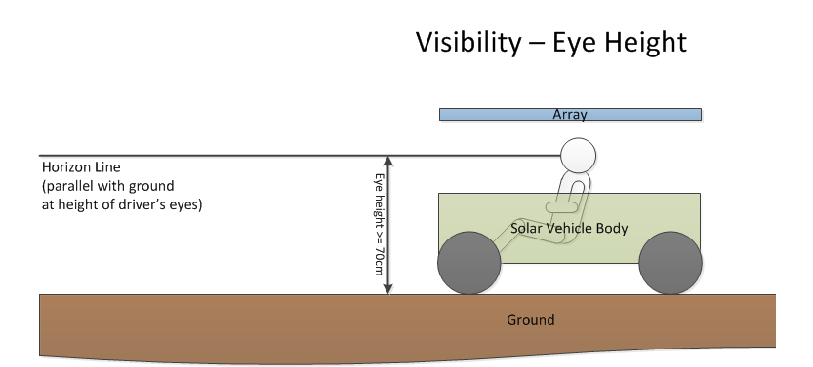
5.5 – Electrical System Grounding – no grounding to frame 5.7 – Wire, Insulation, Connections – properly sized wire (use wire table; sized to continuous system current) 5.9 – Visibility

Slide 22
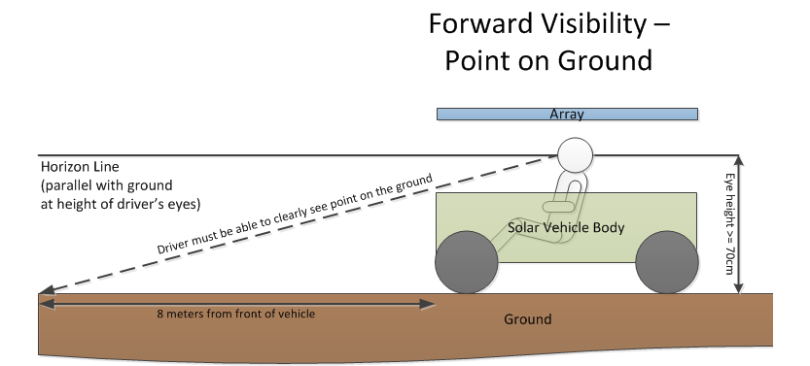

Slide 23
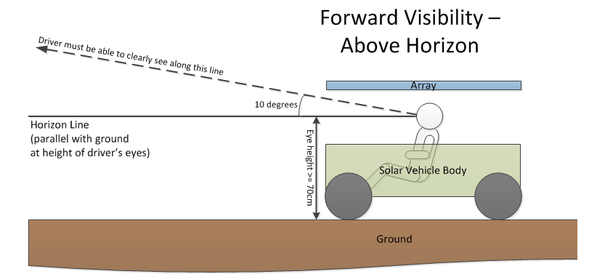

Slide 24
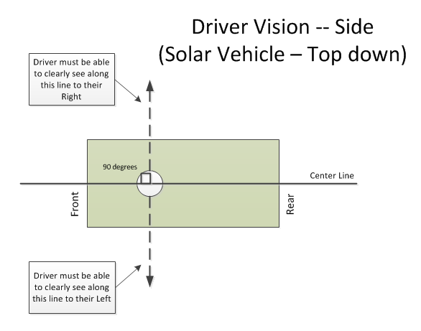
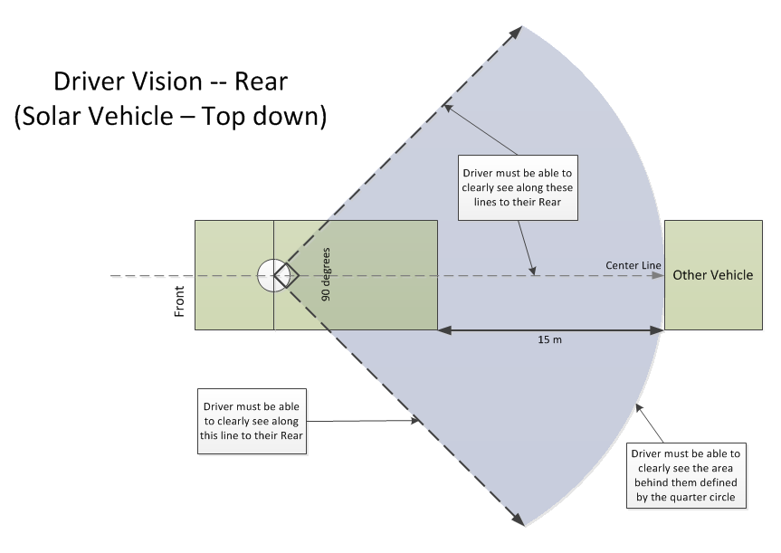

Slide 25
5.10 – Braking Test at Low Speed and High Speed 5.11 – Steering and turning diameter [15-meters] 5.12 – Warning Systems – Turn Signals, Hazards, and Horn Stop – red lights; Turn & Hazards – amber lights. Stop lights must be independent of turn/hazards! Air horns can not be used! 5.13 – Driver Safety (a) Safety Belt – 5 point lap & shoulder belt [Grade 8 bolts] attached to frame of solar car (Not expired!) (b-c) Impact Protection (body shells attached) (d) Windshield must protect driver’s entire face (e) Cockpit egress in 15 seconds (f) Fire extinguishers [Appropriate to battery type] (g) Liquid container properly secured to the vehicle (h) Belly pan (i) Forced Air Circulation (j) Driver seat provides neck support & is bolted to frame (k) Battery spill kit (Lead/Acid batteries - baking soda) (l) Closed toe shoes/hats (m) Protective Eyewear in garage area

Slide 26
5.14 – Throttle 5.15 – Covers & Shields 5.16 – All conductors must be properly insulated. Electrical shock hazards! 5.17 – Radios (if not working, must stop and fix) 5.21 – Waiver requests up to May 1st. 6 – Nature of the Event – Closed Track Race 6.1 – Elapsed time – time spent at required stops is excluded from “elapsed time” 6.2 – Taking part in special events and Challenge Event 6.3 – Items provided by Race 6.4 – Items provided by participants 6.5 – “Trailering” provisions 6.7 – Teams must maintain 20 mph or pull off the road to charge. 6.8 – Charging 6.9 – Impound 6.11 - Attire 7 – Scrutineering 7.8 – Required use of welding screen 8 – Registration 8.3 – Registration Fee (See Event Update No. 2025-1) 8.5 – Team guests must comply with race rules 8.9 – Health Testing required on cross-country events

Slide 27
Sections 9, 11-21: How the race is run; read to understand what a day is like. [We will do extensive explanations during January Workshop] 19. Support vehicles – teams must have three support vehicles on a cross-country race: one lead vehicle, and two chase vehicles. All three vehicles must have flashing amber lights; the two chase vehicles must each have 4 rear-facing ECCO lights. 23. Judging 24. Penalties 25. Protests 29. Responsibility to CHECK EVENT UPDATES

Slide 28
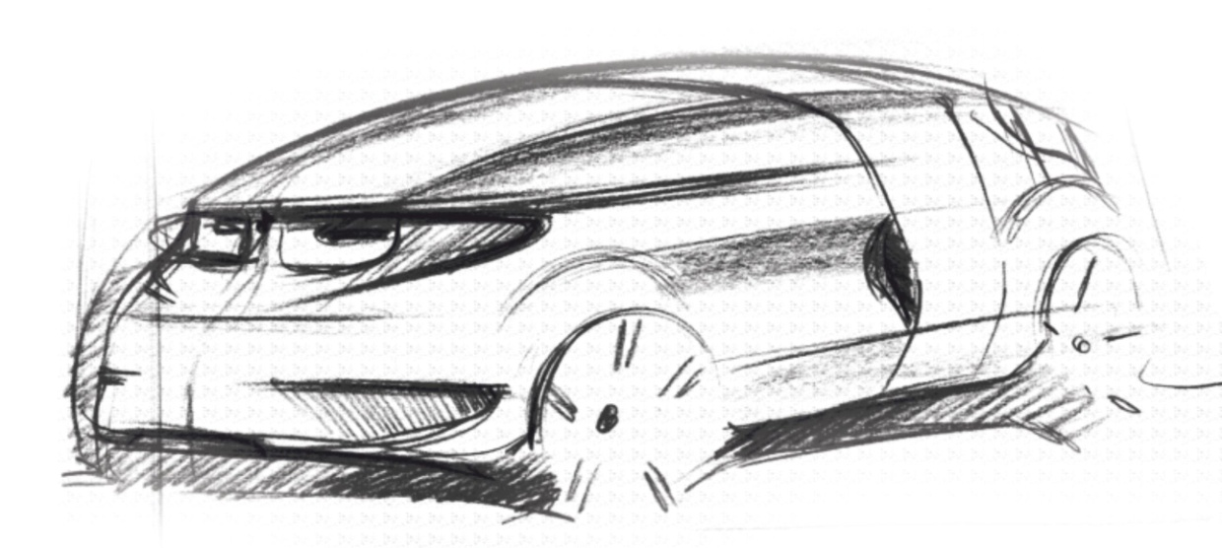
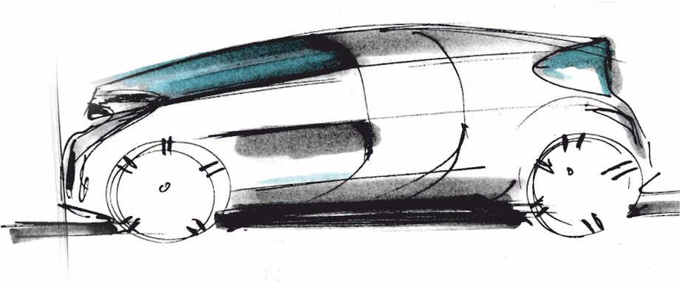
32 – Electric-Solar Powered Car Divisiom

Slide 29
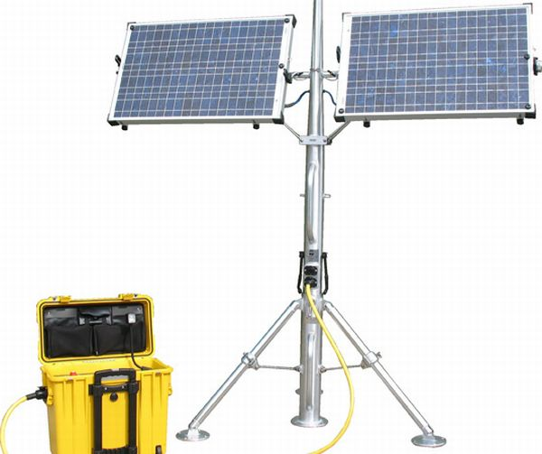
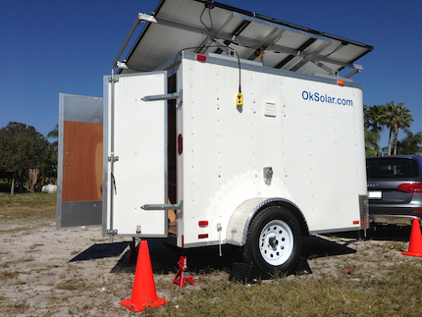
32.1 Concept – The Electric-Solar Power Car Division is designed to simulate a “real world” solar application. (a) Two passenger vehicle (b) Solar Power Charging Station simulates a permanent facility that would be used to charge the vehicle

Slide 30
32.2 Physical Regulations 32.2.1 The Electric-Solar Power Car is governed by all the regulations set out for a Classic Division Solar Car, except where exceptions are provided in this Addendum. 32.2.2 Dimensions – NEW . . . Electric-Solar Powered vehicles will follow the dimension guidelines of Classic Vehicles. 32.2.3 Configuration – the Electric-Solar Powered Car must accommodate two passengers. (one is the driver) 32.1.3 (a) - The passengers must be seated in a comfortable upright position to simulate a “real world” environment. 32.1.3 (b) - One passenger will be designated the “driver”; the other passenger will be designated the “technician” for communications, data collection, and strategy coordination.

Slide 31
32.2.4 Driver Weight – the minimum weight of the two drivers must be a total of at least 320 pounds. If the sum of the drivers’ weight is less than 320 pounds, the solar car must carry a ballast. 32.2.5 Power – powered by interchangeable battery boxes charged by the sun at the team’s Solar Power Charging Station. 32.2.6 Battery - teams can have two battery boxes: one battery box will be in the solar car; the other battery box will be charging at the Solar Power Charging Station. Each battery pack can have up to 5.25 kWh. 32.2.7 – Disconnects - The Electric Solar Powered Car must have two Motor Disconnects per Rule 5.4.5. A single Array Disconnect must be located on the Solar Power Charging Station that is readily accessible to by-standers. No Array Disconnects are required for the Electric Solar Powered Car.

Slide 32
32.3 Solar Power Charging Station 32.3.1 Array – the solar power charging station can have an array with a maximum capacity of 2.5 kW. Solar cells must follow guidelines for Classic Division solar cells. 32.3.2 Location – charging station in designated area, permanent once set up; can be rotated 32.3.3 Stability/Durability – the solar power charging station must be a stable facility capable of withstanding reasonable weather conditions. This includes gusts of wind up to 40 mph and rain. 32.4 Battery Box Exchange Procedures 32.4.1 Batteries exchanged in designated area; monitored by judge 32.4.2 Once installed, solar car moves back onto race course. 32.4.3 Every car will drive a defined track 32.7 Team Assignments – Perform special “real-world” task each day

Slide 33
Rule 33 – Cruiser Division Concept – The Cruiser Division is designed to resemble a regular passenger vehicle and provides teams an opportunity to include strategy by determining the number of passengers to carry throughout the challenge. Teams receive points equivalent to the number of passengers carried multiplied by the distance traveled. 33.2.1 – Governed by Advanced Division Guidelines 33.2.2 – Four Wheels 33.3.3 – Seats four people with four doors (must have 2 roll bars) 33.3.4 – Passenger weight (160 lbs or ballast)(ballast secured) 33.3.5 – Enclosed Body 33.3.6 – Integrated Array 33.3.7 – Trunk and Daily Assignment Points for Driving is based on the number of laps x number of people in the vehicle.

Slide 34
ATTIRE - Attire for all participants (including students, sponsors, chaperones, advisors, and others participating or traveling with team) in the Solar Car Challenge must be appropriate. All participants must wear full-brimmed hats when in direct sunlight and closed-toe shoes throughout the event. Jeans are recommended for protection when working on the car and when kneeling on the ground. Shorts must be longer than the longest fingertip.

Slide 35
Solar Car Challenge Philosophy The Solar Car Challenge is based on the philosophy of “cooperation rather than competition.” Our event focuses on bringing teams together through the camaraderie of the solar car experience.

Slide 36
In keeping with this philosophy, we ask that team attire, banners, and printed materials focus on their solar car team logo, “school pride,” or community. No attire, banners, or printed materials will be allowed that seek to promote any political candidate or philosophy. Failure to follow this guideline will result in the removal of the offending items and/or disqualification from the event.

Slide 37
Use of Solar Car Challenge Logo The Solar Car Challenge logo is the federally registered trademark of the Solar Car Challenge Foundation. It cannot be used by teams for items of attire, banners, or printed materials without the prior written approval of the Solar Car Challenge President.

